Slide 1
Arrays
Fixed-Size Sequences of Elements
0
1
2
3
4
…
…
…
…
…
SoftUni Team
Technical Trainers
Software University
http://softuni.bg

Slide 2
Table of Contents
Arrays
Value vs Reference Types
Reading Arrays from the Console
Foreach Loop

Slide 3
Have a Question?
sli.do
#tech-fund

Slide 4
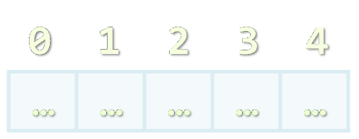
Arrays
Working with Arrays of Elements

Slide 5
What are Arrays?
In programming, an array is a sequence of elements
Elements are numbered from 0 to Length-1
Elements are of the same type (e.g. integers)
Arrays have fixed size (Array.Length) cannot be resized
0
1
2
3
4
Element index
Array of 5 elements
…
…
…
…
…
Element of an array

Slide 6
Working with Arrays
Allocating an array of 10 integers:
Assigning values to the array elements:
Accessing array elements by index:
All elements are initially == 0
int[] numbers = new int[10];
The Length holds the number of array elements
for (int i = 0; i < numbers.Length; i++)
numbers[i] = 1;
The [] operator accesses elements by index
numbers[5] = numbers[2] + numbers[7];
numbers[10] = 1; // IndexOutOfRangeException

Slide 7
Days of Week – Example
The days of week can be stored in array of strings:
string[] days = {
"Monday",
"Tuesday",
"Wednesday",
"Thursday",
"Friday",
"Saturday",
"Sunday"
};
Operator | Notation in C#
days[0] | Monday
days[1] | Tuesday
days[2] | Wednesday
days[3] | Thursday
days[4] | Friday
days[5] | Saturday
days[6] | Sunday

Slide 8
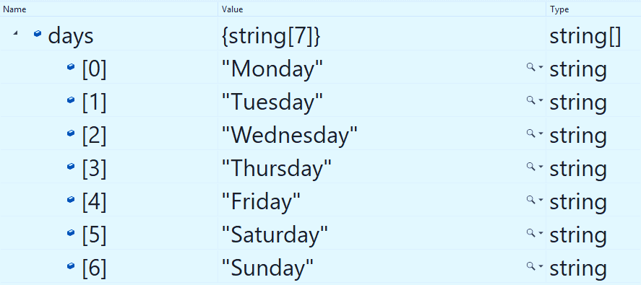
Problem: Day of Week
Enter a day number [1…7] and print the day name (in English) or "Invalid day!"
Check your solution here: https://judge.softuni.bg/Contests/1202

Slide 9
Solution: Day of Week
string[] days = { "Monday", "Tuesday", "Wednesday", "Thursday", "Friday", "Saturday", "Sunday" };
int day = int.Parse(Console.ReadLine());
if (day >= 1 && day <= 7)
Console.WriteLine(days[day - 1]);
else
Console.WriteLine("Invalid day!");
The first day in our array is on index 0, not 1.
Check your solution here: https://judge.softuni.bg/Contests/1202

Slide 10
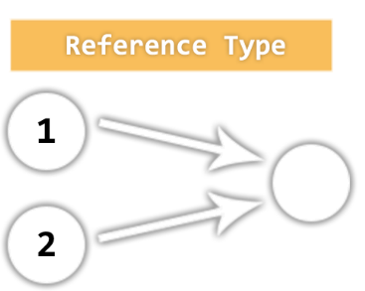
Value vs. Reference Types
Memory Stack and Heap

Slide 11
Value Types
Value type variables hold directly their value
int, float, double, bool, char, BigInteger, …
Each variable has its own copy of the value
Stack
i
42
(4 bytes)
ch
A
(2 bytes)
int i = 42;
char ch = 'A';
bool result = true;
result
true
(1 byte)

Slide 12
Reference Types
Reference type variables hold а reference (pointer / memory address) of the value itself
string, int[], char[], string[], Random
Two reference type variables can reference the same object
Operations on both variables access / modify the same data

Slide 13
Value Types vs. Reference Types
int i = 42;
char ch = 'A';
bool result = true;
object obj = 42;
string str = "Hello";
byte[] bytes ={ 1, 2, 3 };
STACK
HEAP
i
42
(4 bytes)
ch
A
(2 bytes)
result
true
(1 byte)
obj
int32@9ae764
42
4 bytes
str
String@7cdaf2
Hello
string
bytes
byte[]@190d11
1
2
3
byte []

Slide 14
Example: Value Types
public static void Main() {
int num = 5;
Increment(number, 15);
Console.WriteLine(number);
}
public static void Increment(int num, int value) {
num += value;
}
number == 5
num == 20

Slide 15
Example: Reference Types
public static void Main() {
int[] nums = { 5 };
Increment(nums, 15);
Console.WriteLine(nums[0]);
}
public static void Increment(int[] nums, int value) {
nums[0] += value;
}
nums[0] == 20
nums[0] == 20

Slide 16
Value vs. Reference Types

Slide 17

Reading Array
Using a for Loop or String.Split()

Slide 18
Reading Arrays From the Console
First, read from the console the array length:
Next, create an array of given size n and read its elements:
int n = int.Parse(Console.ReadLine());
int[] arr = new int[n];
for (int i = 0; i < n; i++) {
arr[i] = int.Parse(Console.ReadLine());
}

Slide 19
Reading Array Values from a Single Line
Arrays can be read from a single line of separated values
2 8 30 25 40 72 -2 44 56
Split( ) splits by space into string[]
string values = Console.ReadLine();
string[] items = values.Split();
int[] arr = new int[items.Length];
for (int i = 0; i < items.Length; i++)
arr[i] = int.Parse(items[i]);

Slide 20
Shorter: Reading Array from a Single Line
Read an arrays of integers using functional programming:
using System.LINQ;
var inputLine = Console.ReadLine();
string[] items = inputLine.Split(' ');
int[] arr = items.Select(int.Parse).ToArray();
Or shorter
int[] arr = Console.ReadLine().Split(' ')
.Select(int.Parse).ToArray();

Slide 21
Printing Arrays on the Console
To print all array elements, a for-loop can be used
Separate elements with white space or a new line
string[] arr = {"one", "two"};
// == new string [2] {"one", "two"};
// Process all array elements
for (int index = 0; index < arr.Length; index++) {
// Print each element on a separate line
Console.WriteLine("arr[{0}] = {1}", index, arr[index]);
}

Slide 22
Problem: Print Numbers in Reverse Order
Read an array of integers (n lines of integers), reverse it and print its elements on a single line, space-separated:
4 -1
20
99
5
3
10
20
30
30 20 10
5 99 20 -1
Check your solution here: https://judge.softuni.bg/Contests/1202

Slide 23
Solution: Print Numbers in Reverse Order
// Read the array (n lines of integers)
var n = int.Parse(Console.ReadLine());
var arr = new int[n];
for (int i = 0; i < n; i++)
arr[i] = int.Parse(Console.ReadLine());
// Print the elements from the last to the first
for (int i = n-1; i >= 0; i--)
Console.Write(arr[i] + " ");
Console.WriteLine();
Check your solution here: https://judge.softuni.bg/Contests/1202

Slide 24
Problem: Rounding Numbers
Read an array of real numbers (space separated), round them in "away from 0" style and print the output as in the examples:
0.9 1.5 2.4 2.5 3.14
-5.01 -1.599 -2.5 -1.50 0
0.9 => 1
1.5 => 2
2.4 => 2
2.5 => 3
3.14 => 3
-5.01 => -5
-1.599 => -2
-2.5 => -3
-1.50 => -2
0 => 0
Check your solution here: https://judge.softuni.bg/Contests/1202

Slide 25
Solution: Rounding Numbers
Rounding turns each value to the nearest integer
double[] nums = ReadNumbers(); // write your method
int[] roundedNums = new int[nums.Length];
for (int i = 0; i < nums.Length; i++) {
roundedNums[i] = (int)Math
.Round(nums[i], MidpointRounding.AwayFromZero);
}
// TODO: Print each number
2.5 => 3
Check your solution here: https://judge.softuni.bg/Contests/1202

Slide 26
Printing Arrays with for / String.Join(…)
Use for-loop:
Use string.Join(separator, array):
int[] arr = { 10, 20, 30, 40, 50};
for (int i = 0; i < arr.Length; i++)
Console.WriteLine(arr[i]);
int[] arr = { 1, 2, 3 };
Console.WriteLine(string.Join(", ", arr)); // 1, 2, 3
string[] strings = { "one", "two" };
Console.WriteLine(string.Join(" - ", strings)); // one - two

Slide 27
Problem: Reverse Array of Strings
Read an array of strings (space separated values), reverse it and print its elements:
Reversing array elements:
a b c d e
e d c b a
-1 hi ho w
w ho hi -1
exchange
a
b
c
d
e
Check your solution here: https://judge.softuni.bg/Contests/1202

Slide 28
Solution: Reverse Array of Strings
var nums = Console.ReadLine().Split(' ').ToArray();
for (int i = 0; i < nums.Length / 2; i++)
SwapElements(nums, i, nums.Length - 1 - i);
Console.WriteLine(string.Join(" ", nums));
static void SwapElements(string[] arr, int i, int j) {
var oldElement = arr[i];
arr[i] = arr[j];
arr[j] = oldElement;
}
Check your solution here: https://judge.softuni.bg/Contests/1202

Slide 29

Foreach Loop
Iterate through Collections

Slide 30
Foreach Loop
Iterates through all elements in a collection
Cannot access the current index
Read-only
foreach (var item in collection)
{
// Process the value here
}

Slide 31
Print an Array with Foreach
int[] numbers = { 1, 2, 3, 4, 5 };
foreach (int number in numbers)
{
Console.Write($"{number} ");
}
1 2 3 4 5

Slide 32

Live Exercises

Slide 33

Summary
…
…
…
Arrays hold a sequence of elements
Elements are numbered from 0 to length-1
Creating (allocating) an array
Accessing array elements by index
Printing array elements

Slide 34
https://softuni.bg/trainings/courses

Slide 35













SoftUni Diamond Partners

Slide 36





SoftUni Organizational Partners

Slide 37




Trainings @ Software University (SoftUni)
Software University – High-Quality Education and Employment Opportunities
softuni.bg
Software University Foundation
http://softuni.foundation/
Software University @ Facebook
facebook.com/SoftwareUniversity
Software University Forums
forum.softuni.bg

Slide 38

License
This course (slides, examples, demos, videos, homework, etc.) is licensed under the "Creative Commons Attribution-NonCommercial-ShareAlike 4.0 International" license

